Slide 1
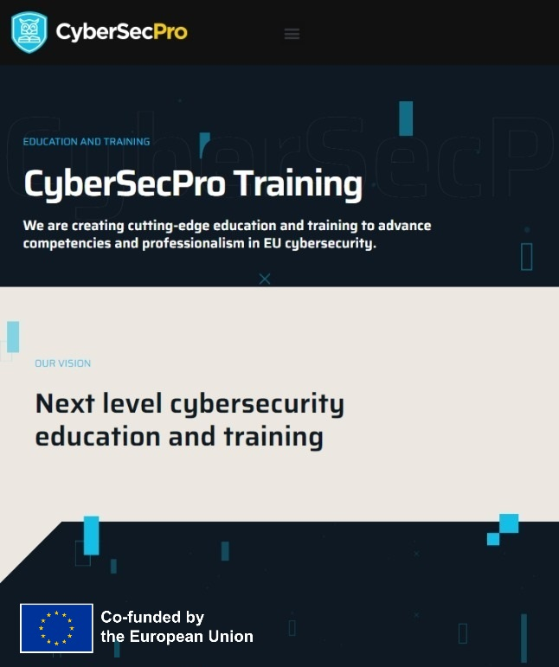


Risk Management and Risk Assessment
Presentation by:
Stylianos Karagiannis
PostDoc @ Ionian University, Researcher@PDMFC, Portugal

Slide 2
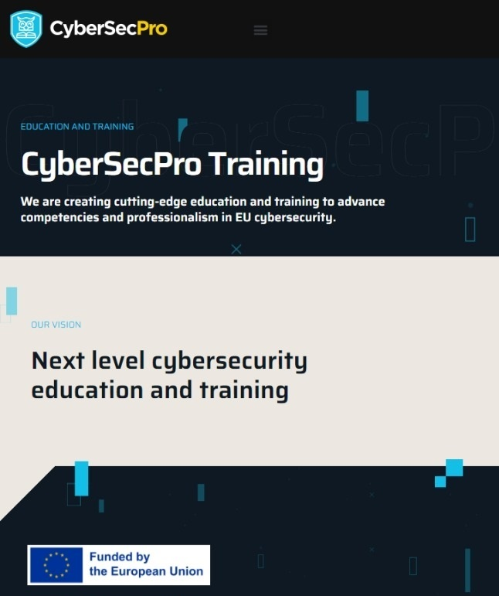
Acknowledgement
Funded by the European Union. Views and opinions expressed are however those of the author(s) only and do not necessarily reflect those of the European Union or HADEA. Neither the European Union nor the granting authority can be held responsible for them.
Project Agreement no. 101083594

Slide 3
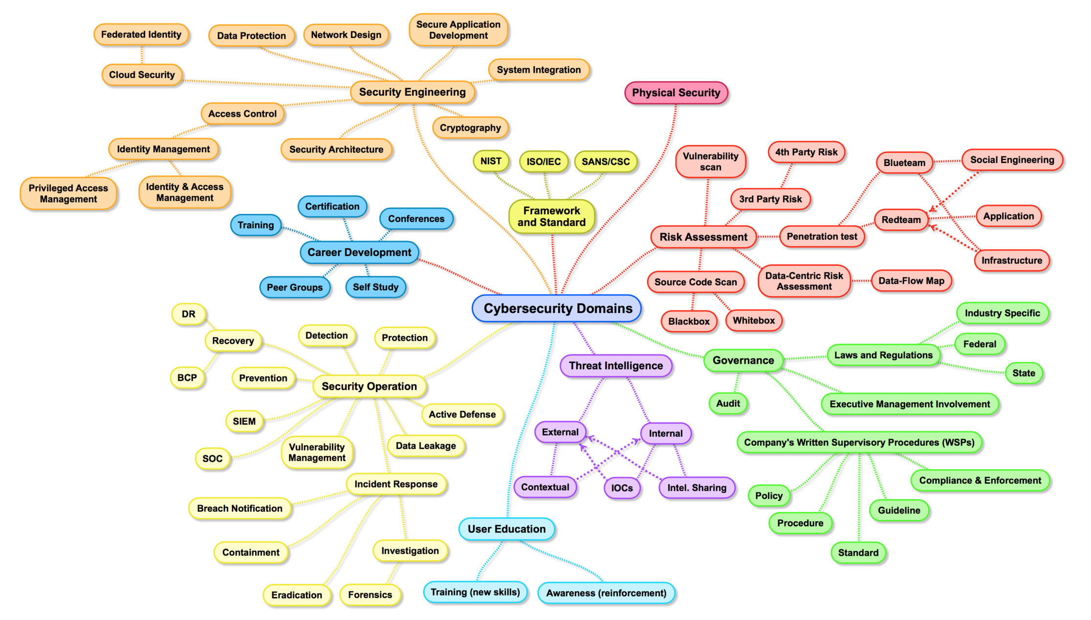
Reference: Henry Jiang - Cybersecurity Domain Map ver 3.0

Slide 4
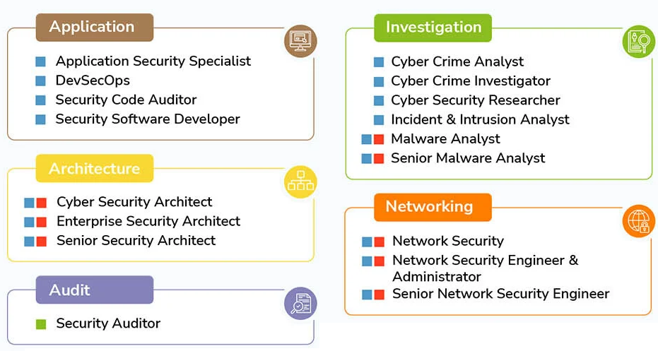
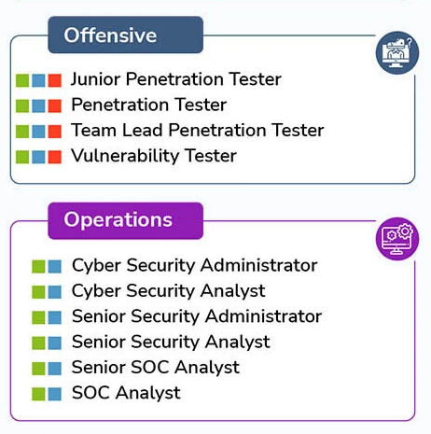
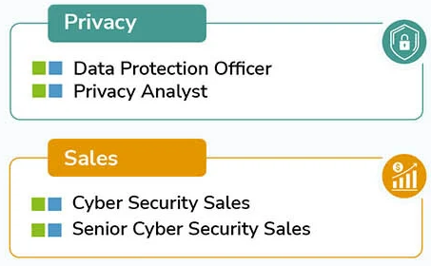
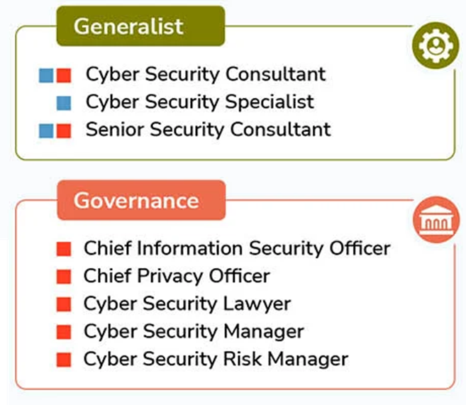
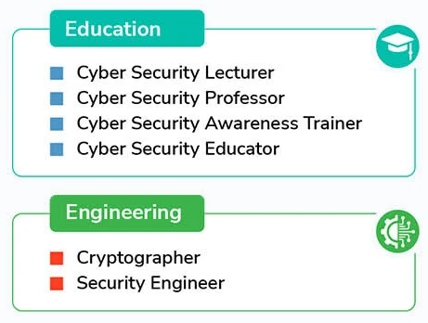
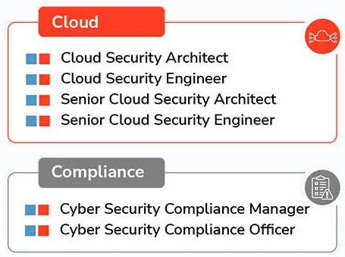
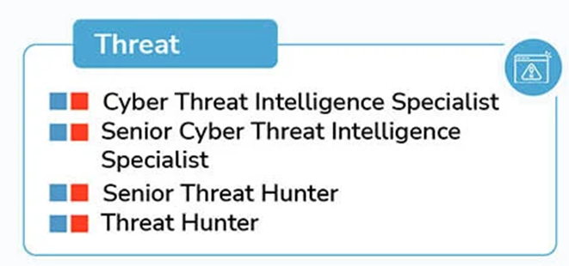

Reference: How to Get Into Cyber Security in 2024: A Quick Guide - StationX

Slide 5
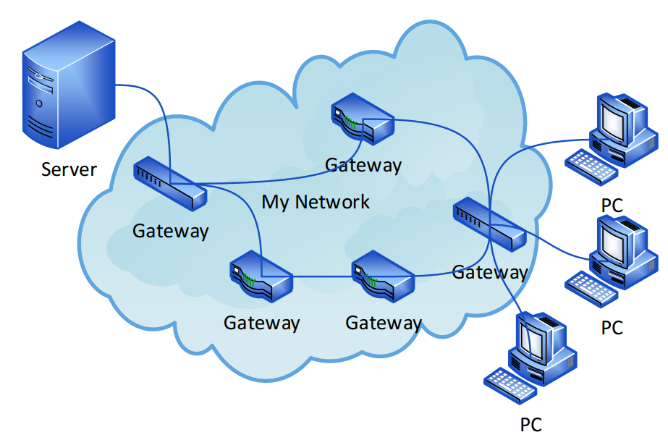


Slide 6
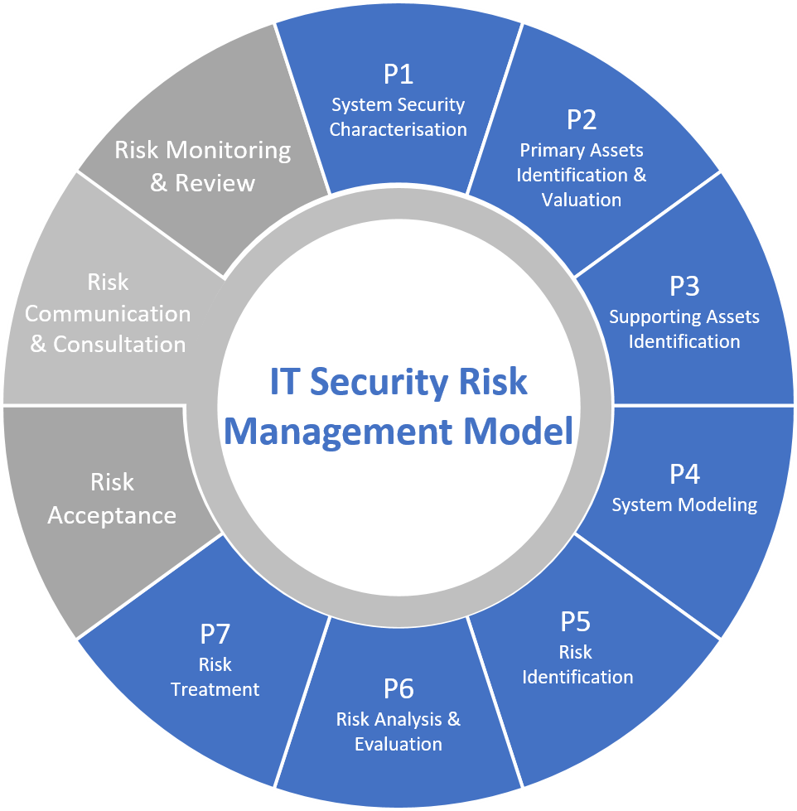
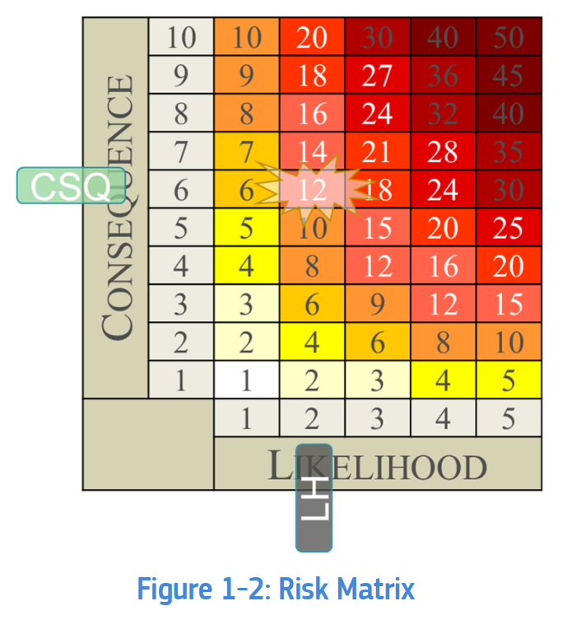
Reference:
Foundations of IT Security and Risk Management (ITSRM)

Slide 7
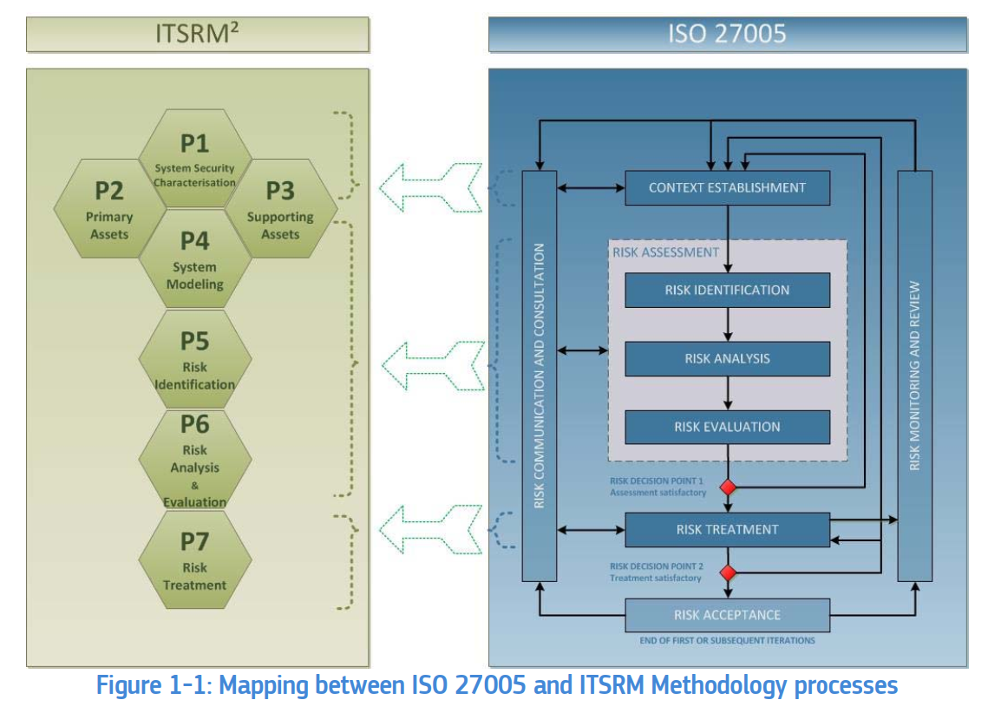

Slide 8
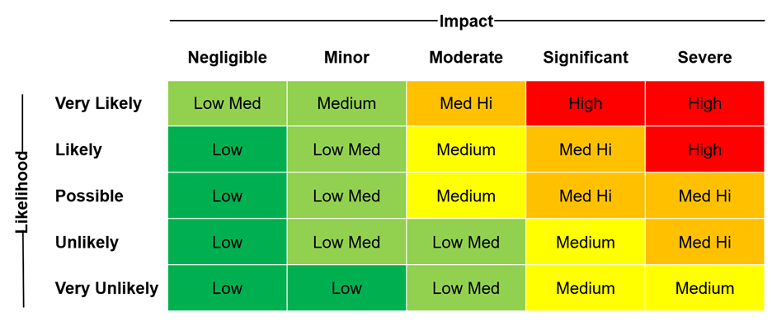

Slide 9
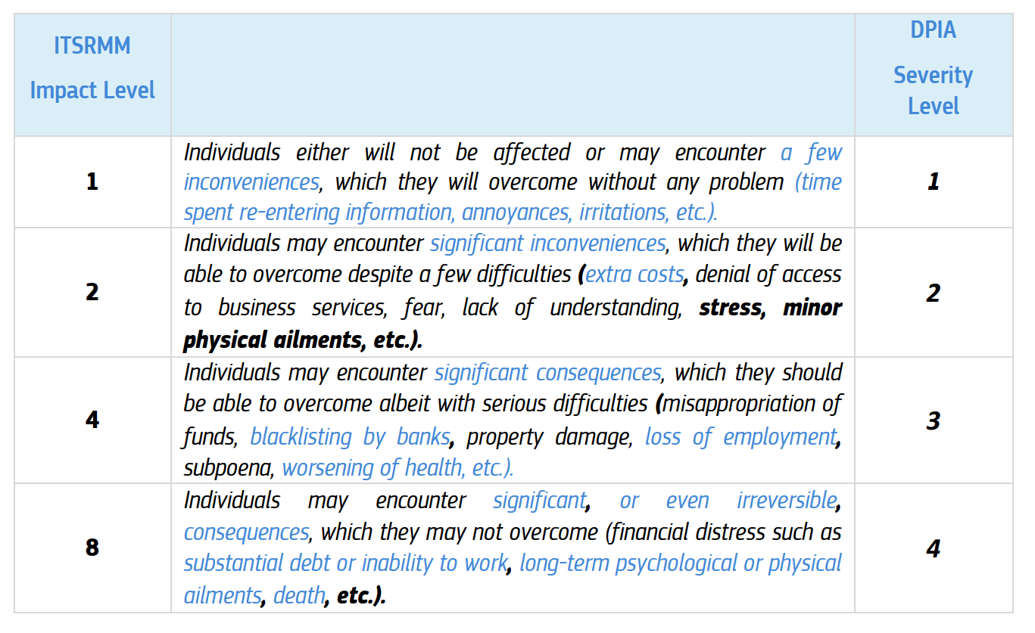

Slide 10
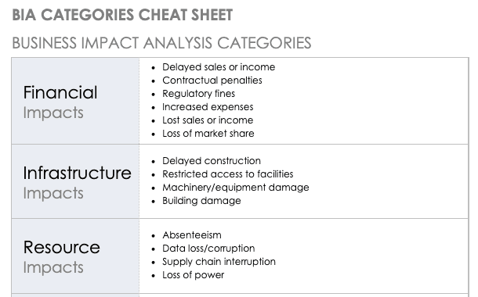

Slide 11
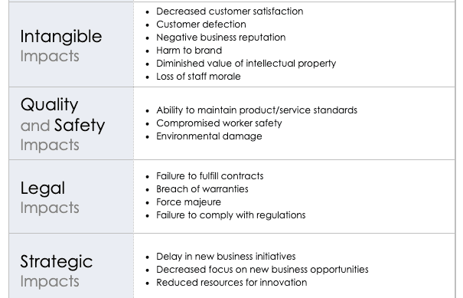

Slide 12
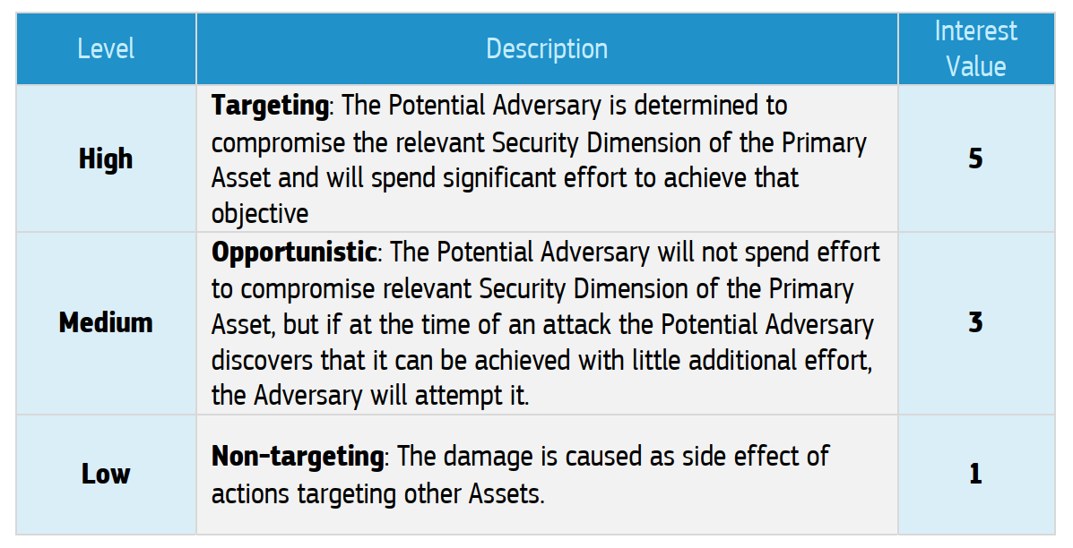

Slide 13
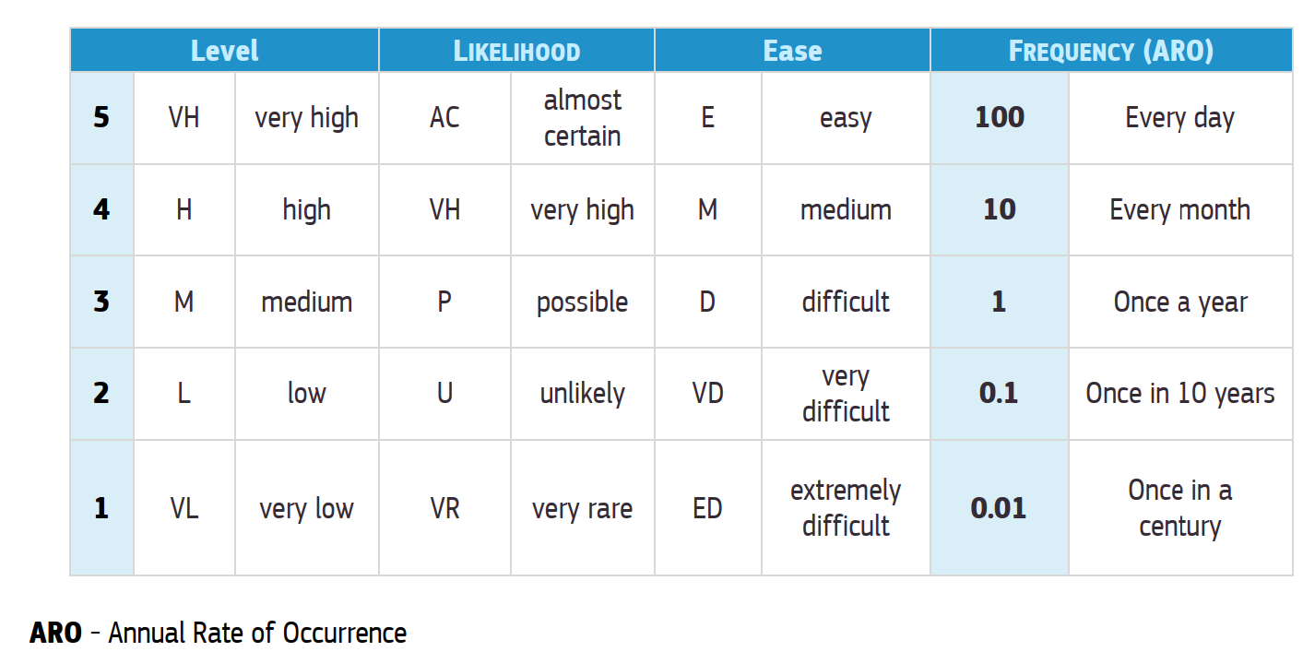

Slide 14
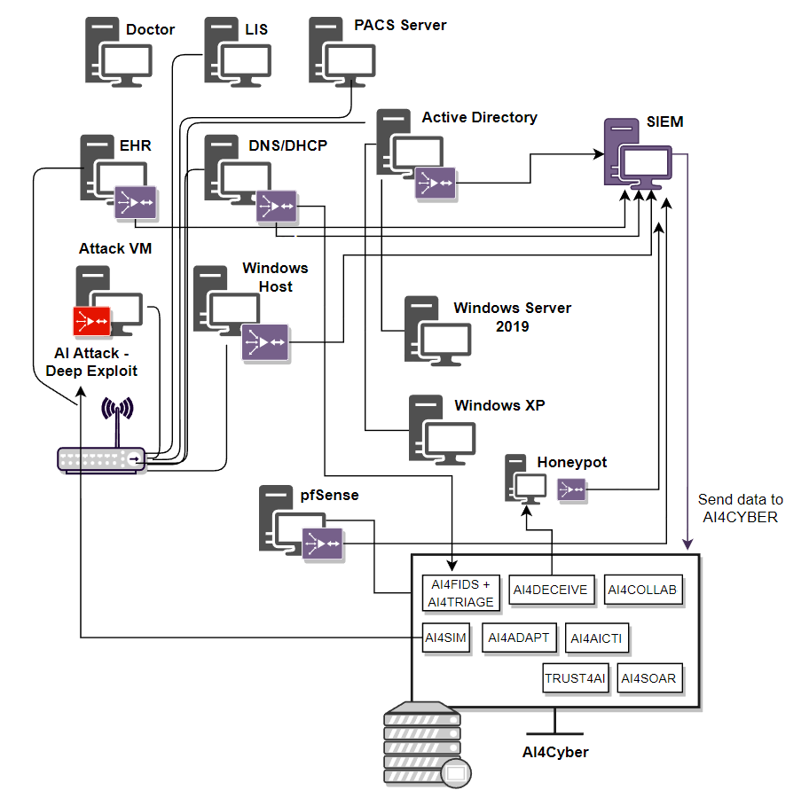

Slide 15
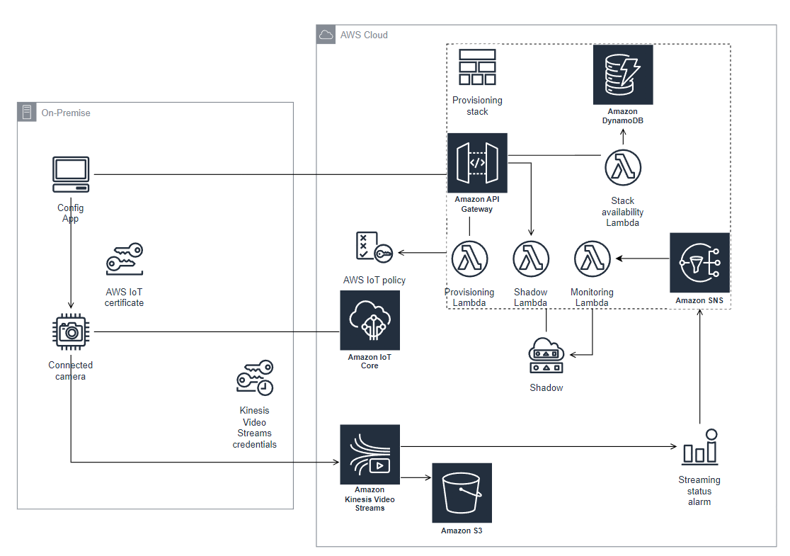

Slide 16
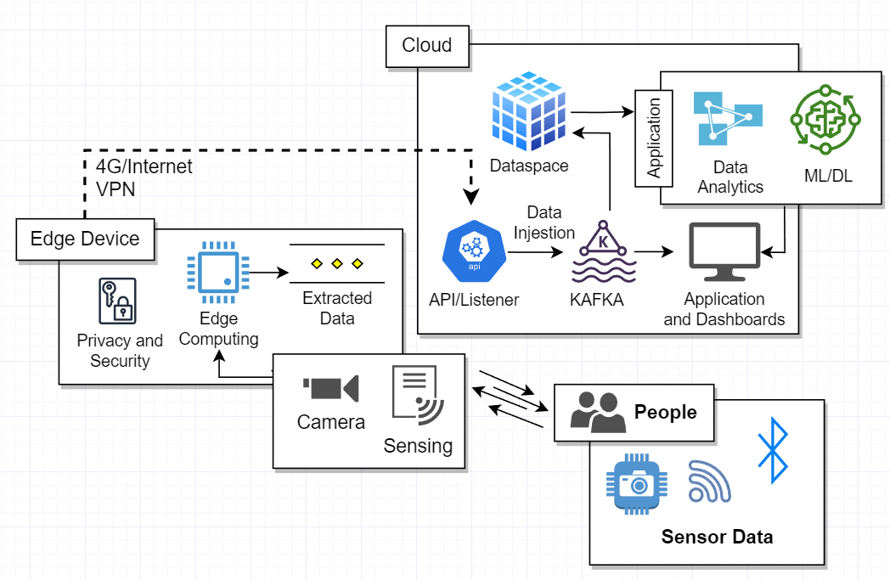

Slide 17
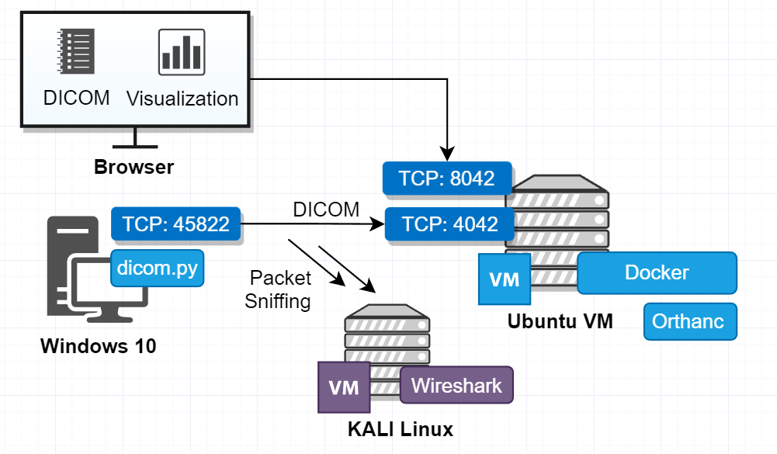

Slide 18
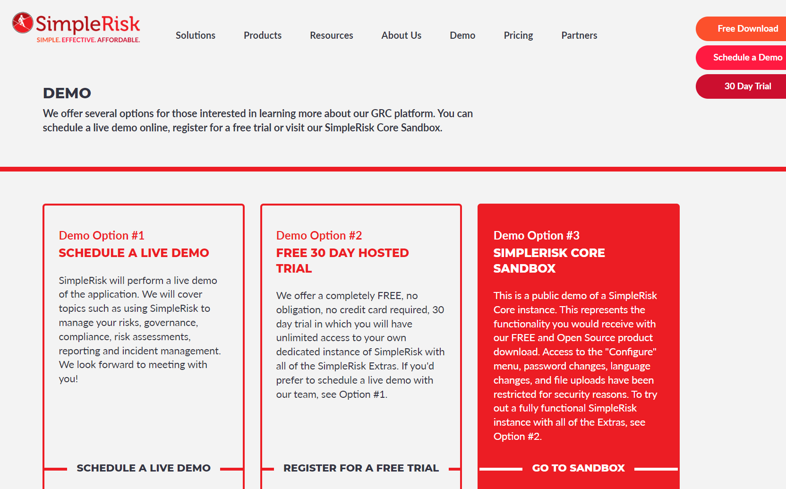

Slide 19
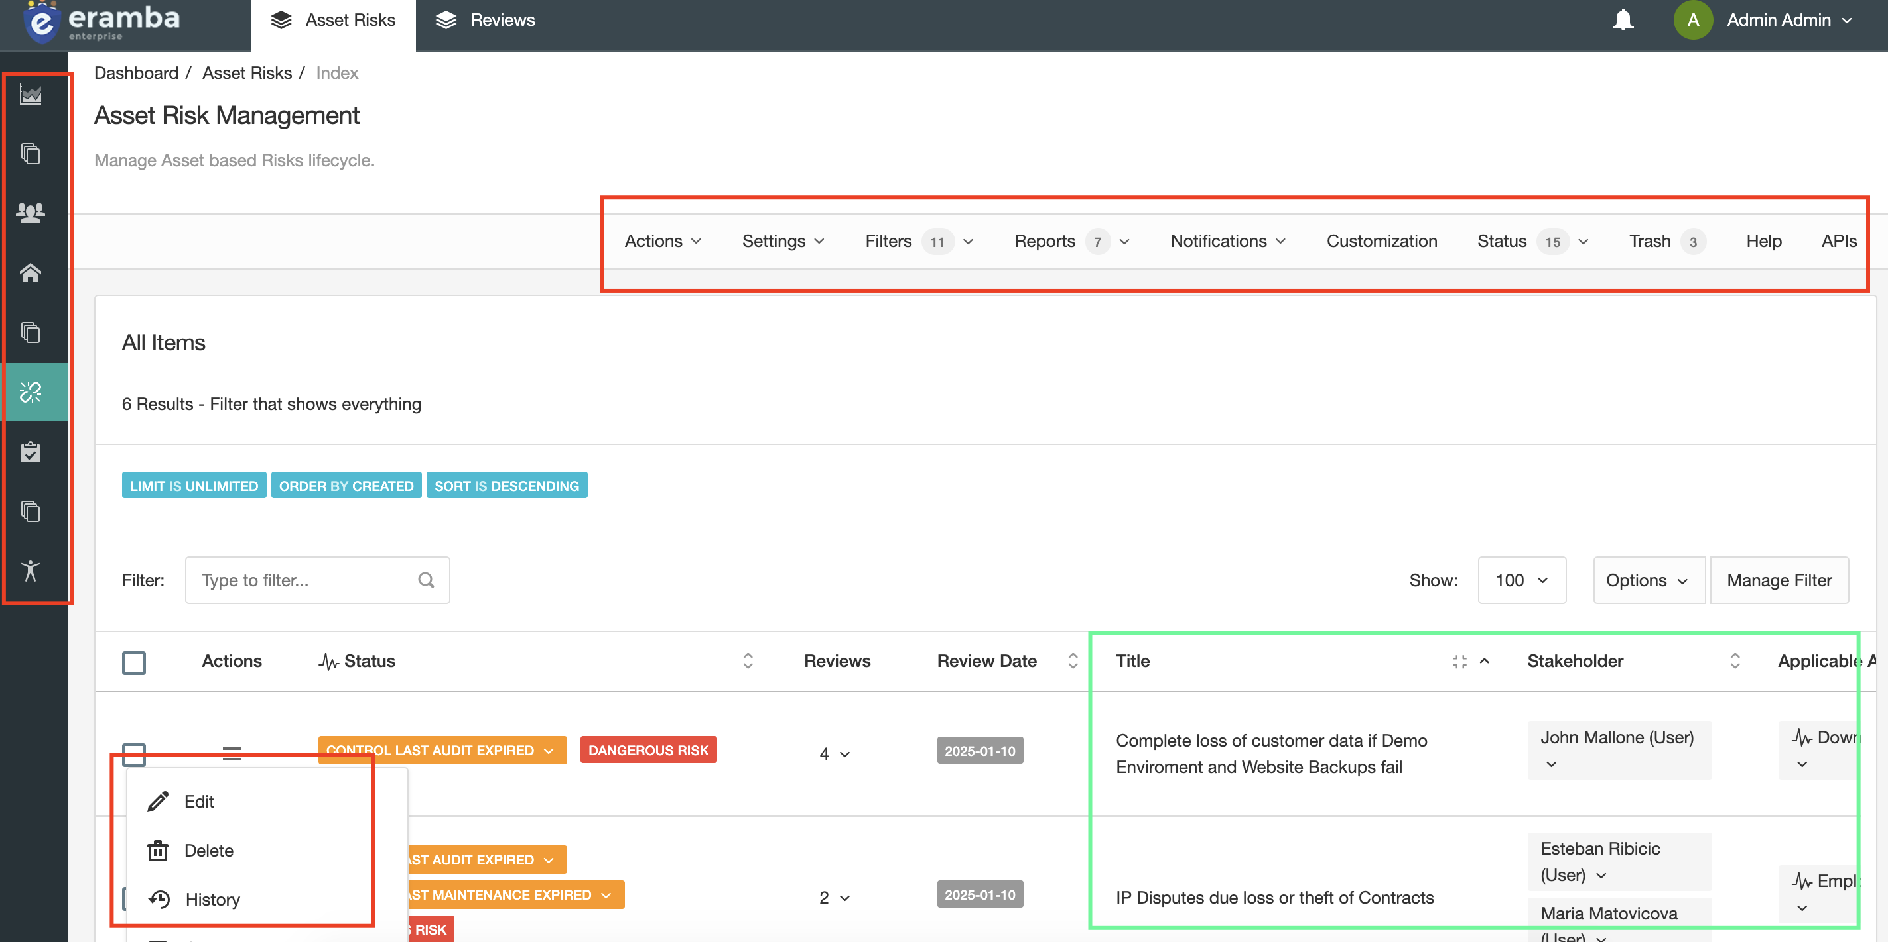

Slide 20
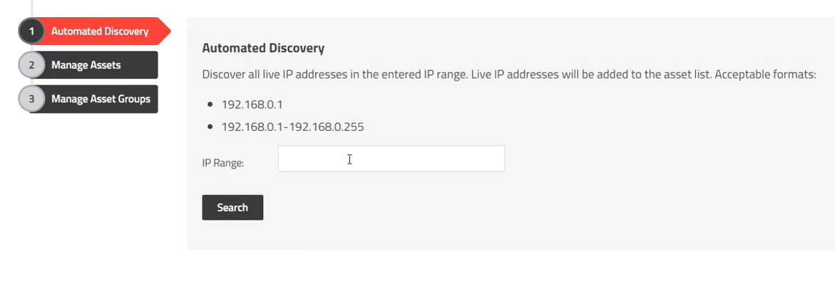

Slide 21
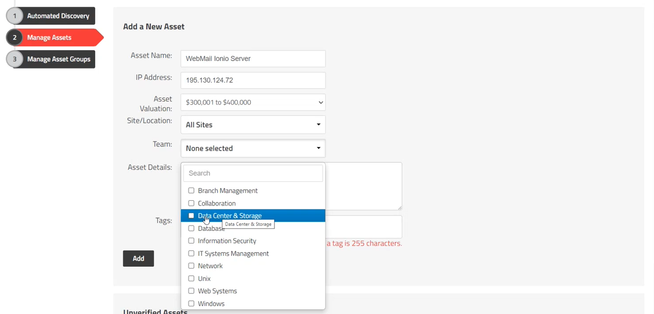

Slide 22
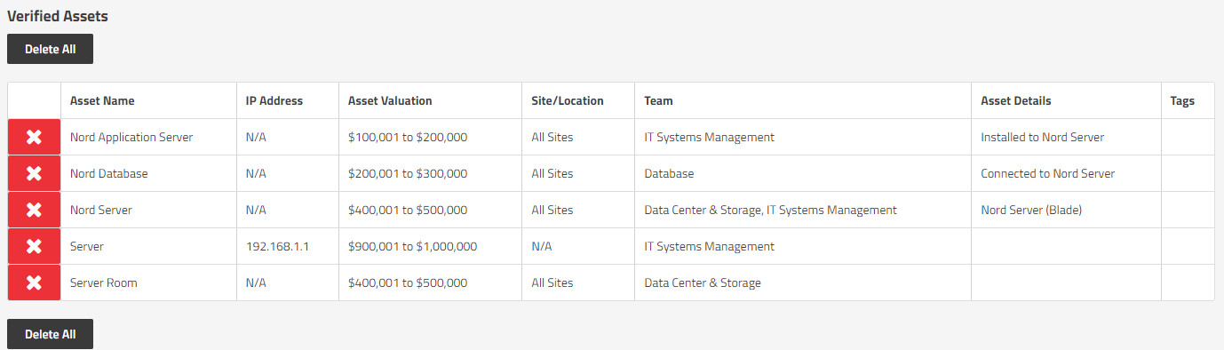
SimpleRisk – Add-discovery Assets
22
View – Show View – Information Security Level

Slide 23
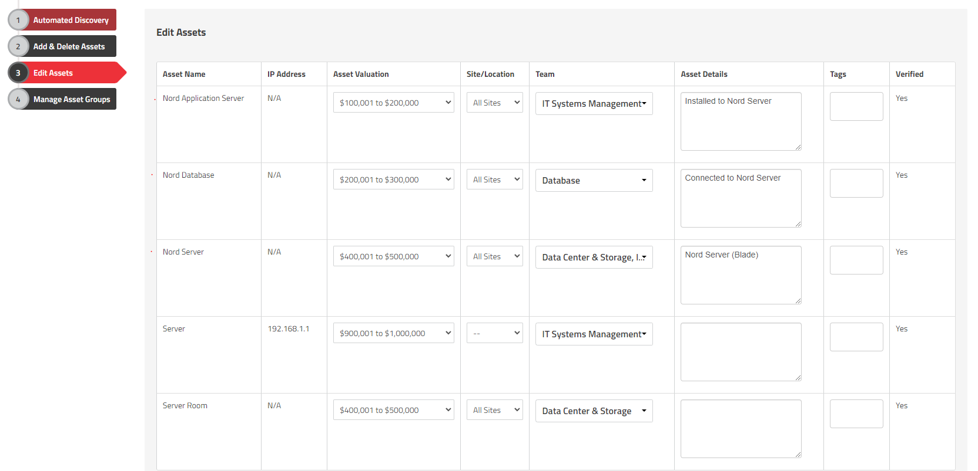
SimpleRisk – Edit Assets
23
View – Show View – Information Security Level

Slide 24
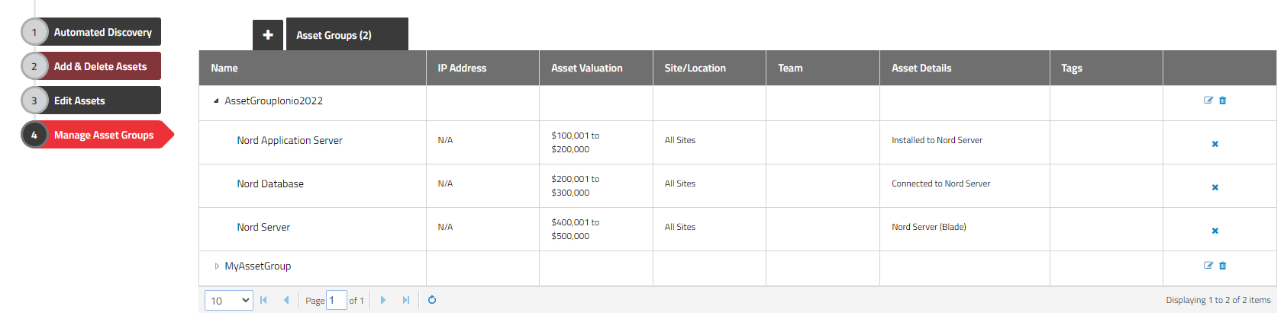
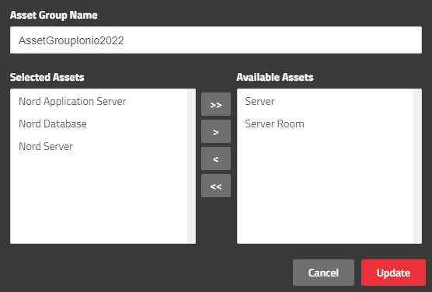
SimpleRisk – Asset Group
24
View – Show View – Information Security Level

Slide 25
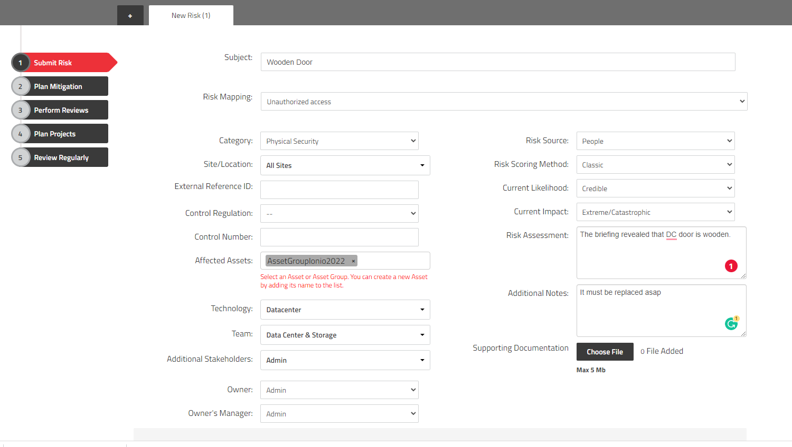
SimpleRisk – Submit Risk
25
View – Show View – Information Security Level

Slide 26
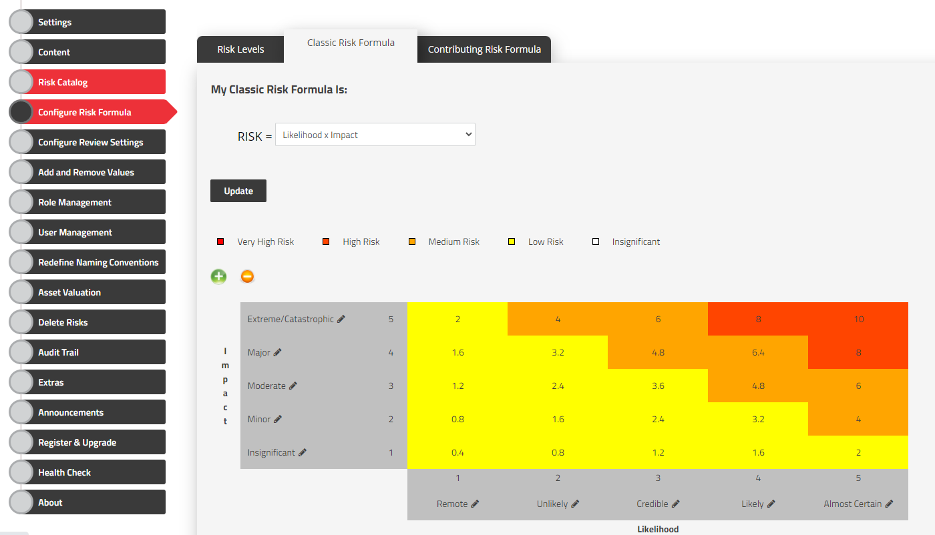
Risk Formulas

Slide 27
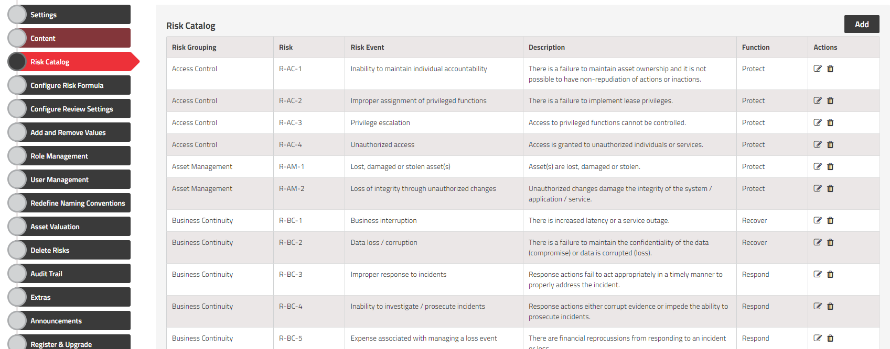
Risk Catalog (NIST not 27002)

Slide 28
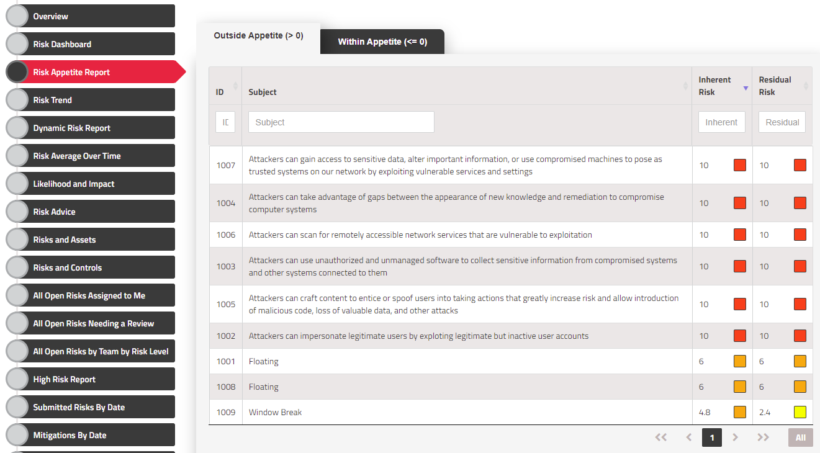
SimpleRisk - Reports
28

Slide 29
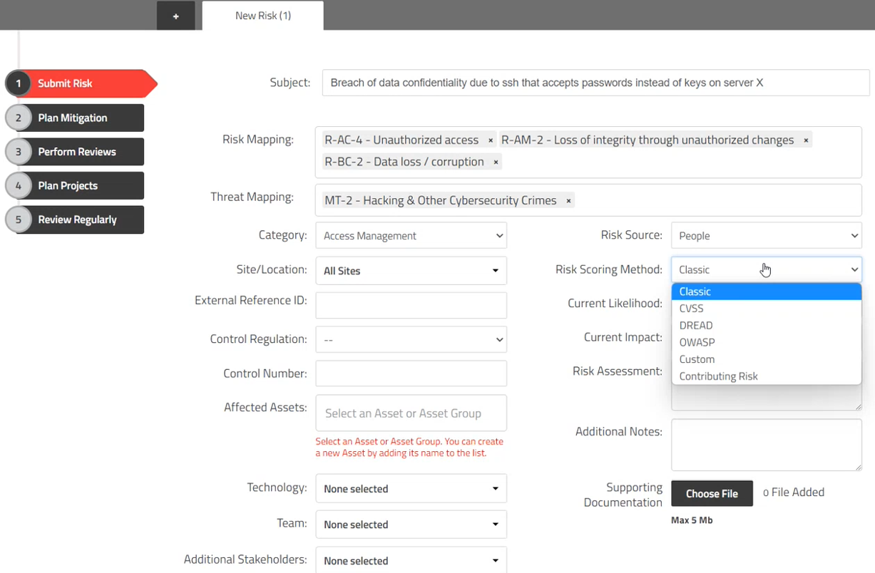

Slide 30
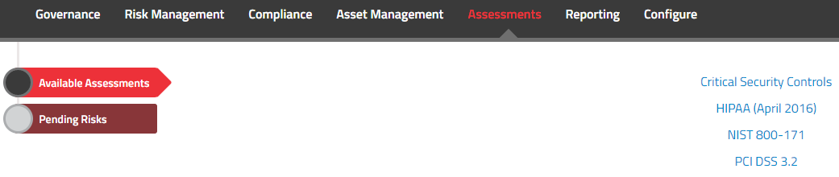
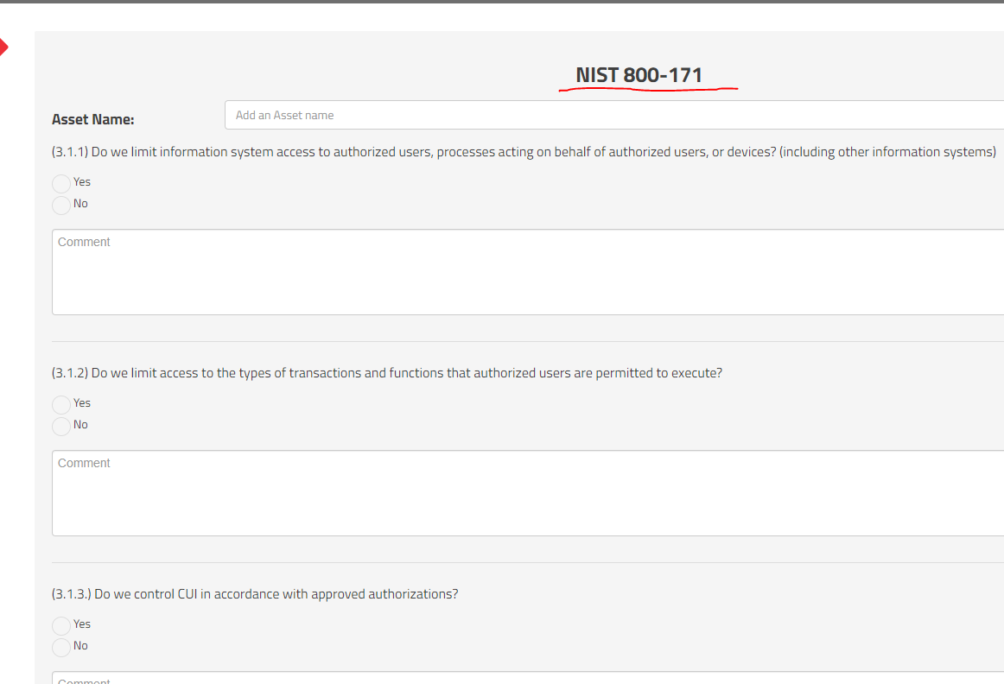
SimpleRisk – Auto Assessments
30
View – Show View – Information Security Level

Slide 31
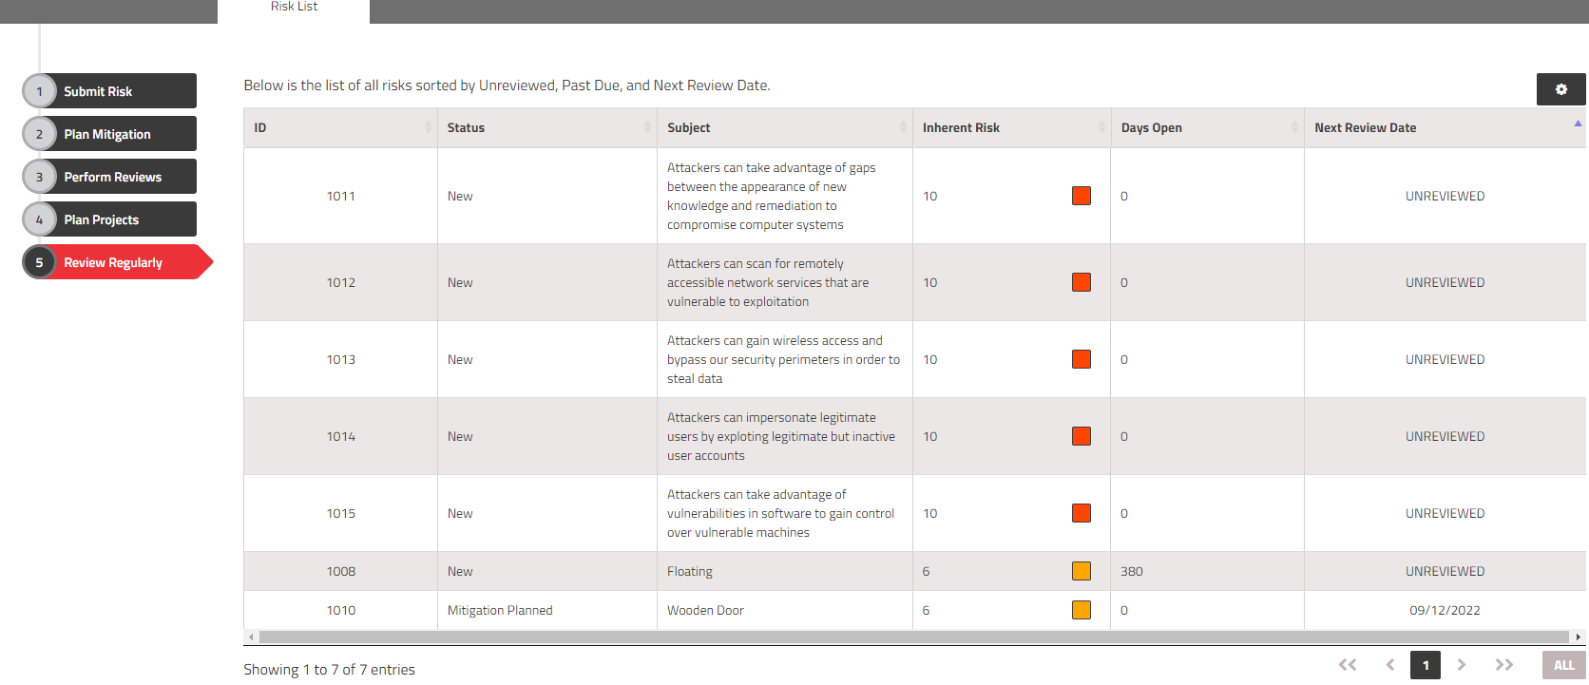
SimpleRisk – Auto Assessments
31
View – Show View – Information Security Level

Slide 32
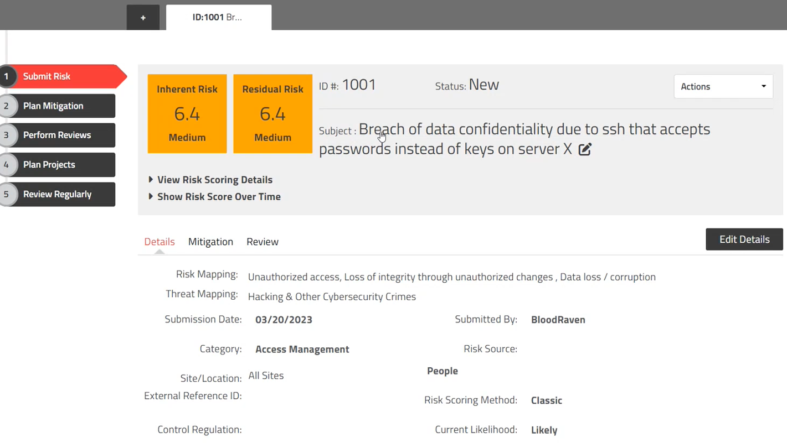

Slide 33
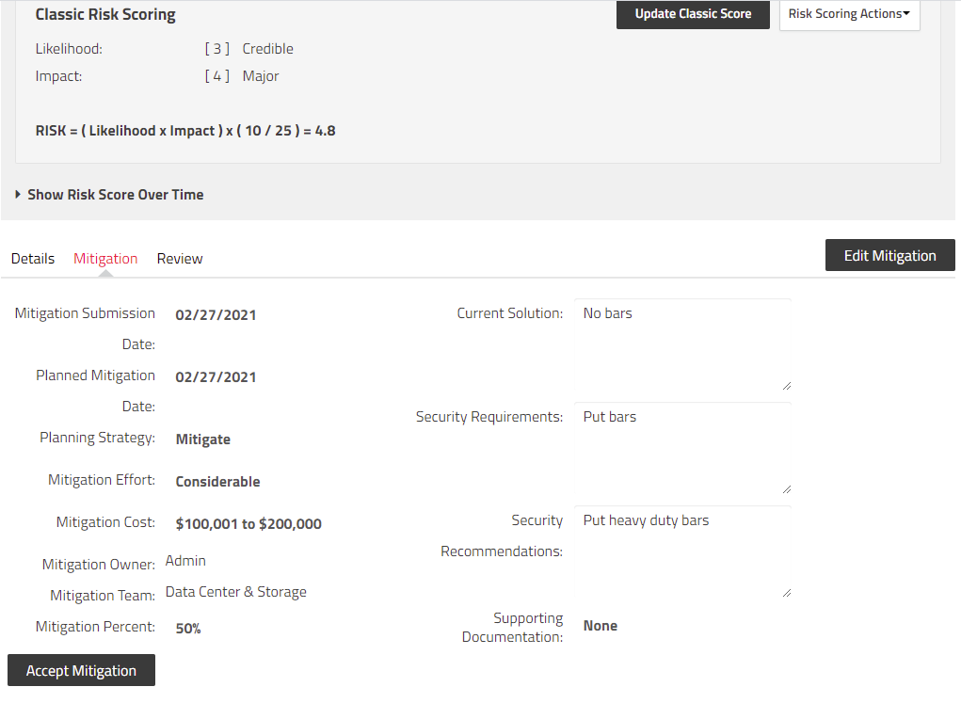
SimpleRisk – Mitigation Plan
33

Slide 34
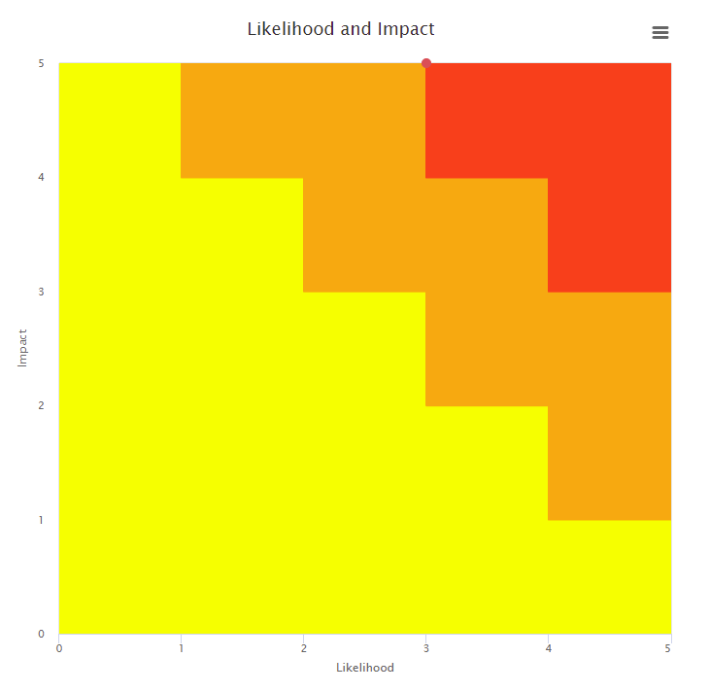
SimpleRisk - Reports
34

Slide 35
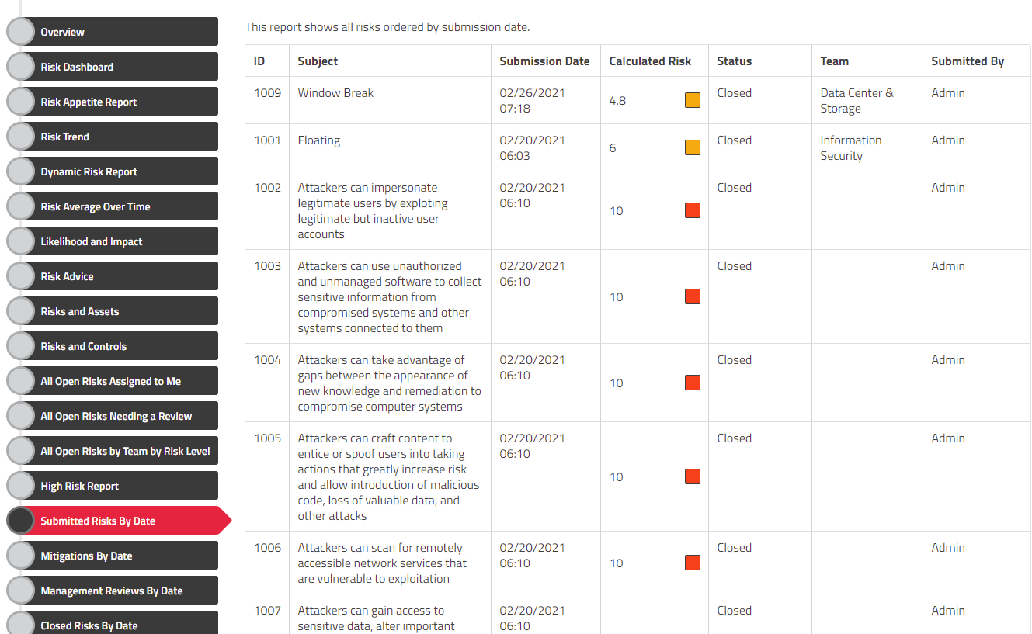
SimpleRisk - Reports
35

Slide 36
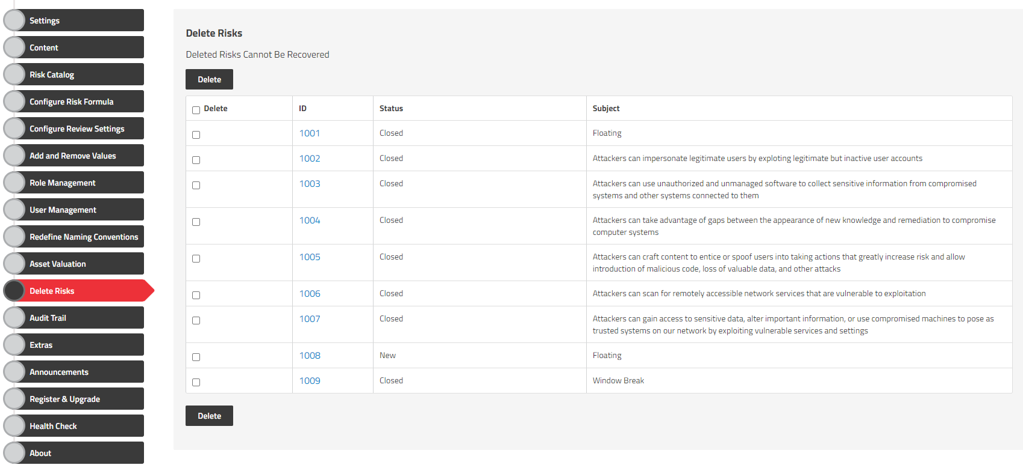
Delete Risks

Slide 37
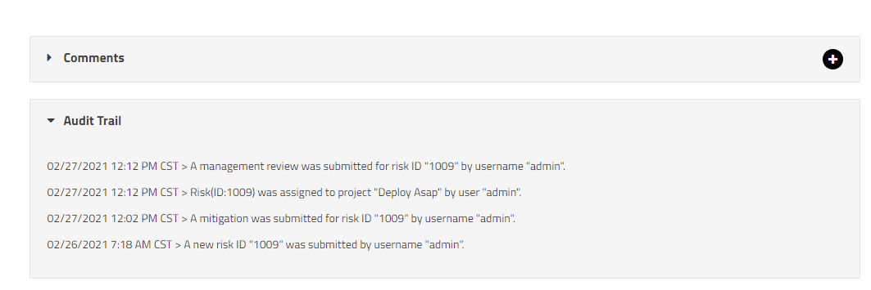
SimpleRisk – Audit Trail
37

Slide 38
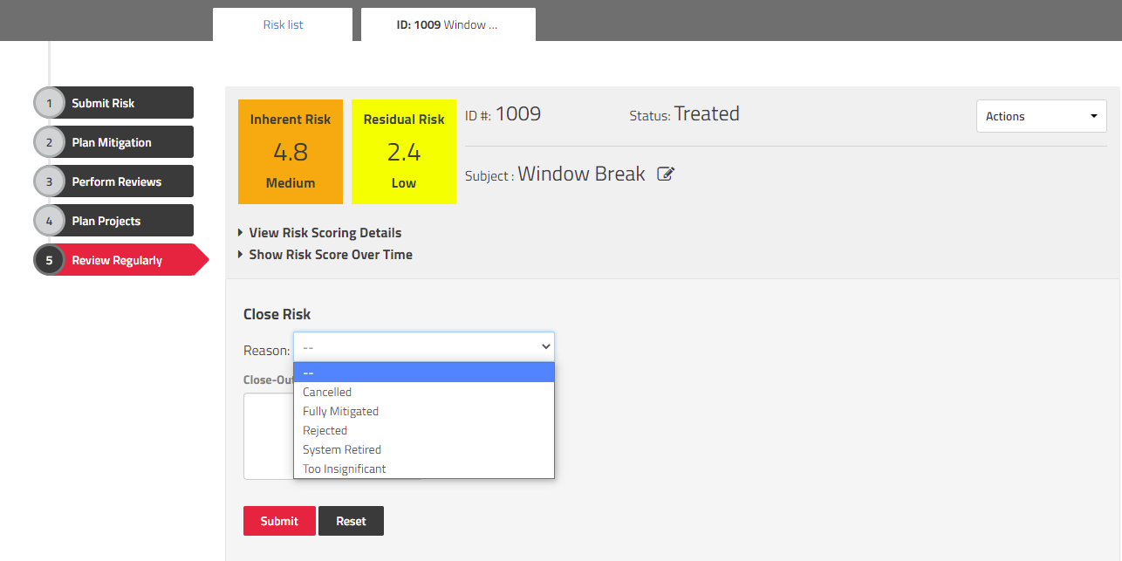
SimpleRisk – Status : Close
38

Slide 39
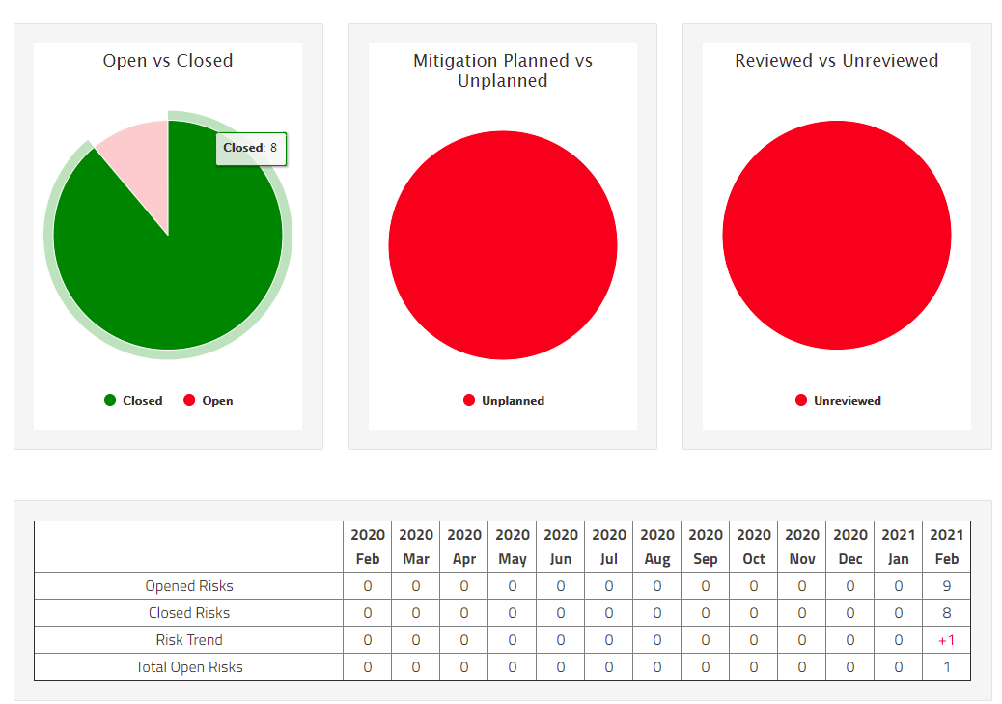
SimpleRisk - Reports
39

Slide 40
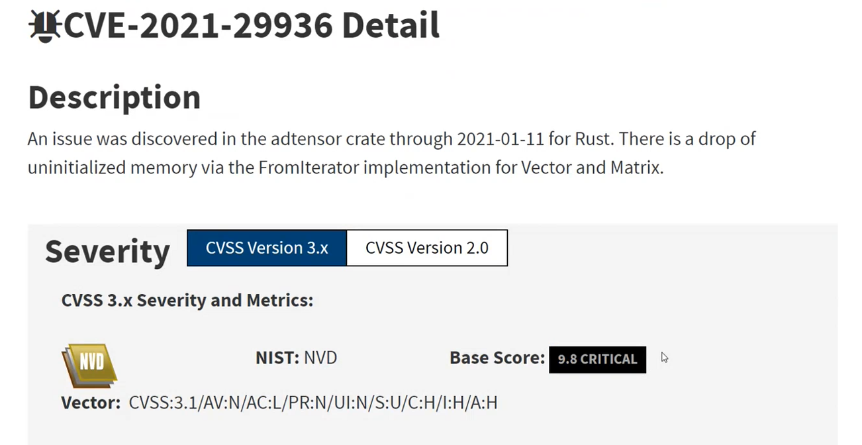

Slide 41
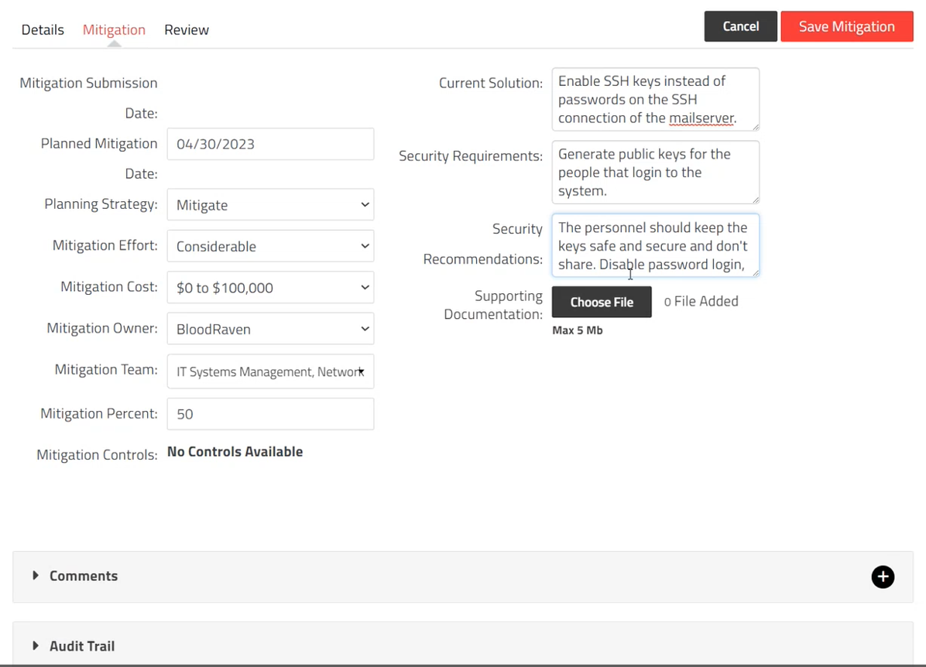

Slide 42


Slide 43


Slide 44


Slide 45


Slide 46


Slide 47
Demonstration Links
[AZURE Security Controls] https://github.com/MicrosoftDocs/azure-docs/blob/main/articles/governance/policy/samples/nist-sp-800-53-r4.md
[AMAZON AWS Security Controls] https://docs.aws.amazon.com/securityhub/latest/userguide/ec2-controls.html
[Learning Material for Risk Management] https://www.eramba.org/learning
[Packages with Security Controls e.g. Full NIST 800-52 Compliance] https://www.eramba.org/learning/courses/9/episodes/203

Slide 48



Slide 49
Data risks
AI systems rely on data sets that might be vulnerable to tampering, breaches, bias or cyberattacks. Organizations can mitigate these risks by protecting data integrity, security and availability throughout the entire AI lifecycle, from development to training and deployment.
Common data risks include:
Data security: Data security is one of the biggest and most critical challenges facing AI systems. Threat actors can cause serious problems for organizations by breaching the data sets that power AI technologies, including unauthorized access, data loss and compromised confidentiality.
Data privacy: AI systems often handle sensitive personal data, which can be vulnerable to privacy breaches, leading to regulatory and legal issues for organizations.
Data integrity: AI models are only as reliable as their training data. Distorted or biased data can lead to false positives, inaccurate outputs or poor decision-making.
(Reference: https://www.ibm.com/blog/ai-risk-management/)

Slide 50
Model risks
Threat actors can target AI models for theft, reverse engineering or unauthorized manipulation.
Adversarial attacks: These attacks manipulate input data to deceive AI systems into making incorrect predictions or classifications. For instance, attackers might generate adversarial examples that they feed to AI algorithms to purposefully interfere with decision-making or produce bias.
Prompt injections: These attacks target large language models (LLMs). Hackers disguise malicious inputs as legitimate prompts, manipulating generative AI systems into leaking sensitive data, spreading misinformation or worse. Even basic prompt injections can make AI chatbots like ChatGPT ignore system guardrails and say things that they shouldn’t.
Model interpretability: Complex AI models are often difficult to interpret, making it hard for users to understand how they reach their decisions. This lack of transparency can ultimately impede bias detection and accountability while eroding trust in AI systems and their providers.
Supply chain attacks: Supply chain attacks occur when threat actors target AI systems at the supply chain level, including at their development, deployment or maintenance stages. For instance, attackers might exploit vulnerabilities in third-party components used in AI development, leading to data breaches or unauthorized access.
(Reference: https://www.ibm.com/blog/ai-risk-management/)

Slide 51
Operational risks
Though AI models can seem like magic, they are fundamentally products of sophisticated code and machine learning algorithms. Like all technologies, they are susceptible to operational risks. Left unaddressed, these risks can lead to system failures and security vulnerabilities that threat actors can exploit.
Some of the most common operational risks include:
Drift or decay: AI models can experience model drift, a process where changes in data or the relationships between data points can lead to degraded performance. For example, a fraud detection model might become less accurate over time and let fraudulent transactions slip through the cracks.
Sustainability issues: AI systems are new and complex technologies that require proper scaling and support. Neglecting sustainability can lead to challenges in maintaining and updating these systems, causing inconsistent performance and increased operating costs and energy consumption.
Integration challenges: Integrating AI systems with existing IT infrastructure can be complex and resource-intensive. Organizations often encounter issues with compatibility, data silos and system interoperability. Introducing AI systems can also create new vulnerabilities by expanding the attack surface for cyberthreats.
Lack of accountability: With AI systems being relatively new technologies, many organizations don’t have the proper corporate governance structures in place. The result is that AI systems often lack oversight. McKinsey found that just 18 percent of organizations have a council or board with the authority to make decisions about responsible AI governance.
(Reference: https://www.ibm.com/blog/ai-risk-management/)

Slide 52
Ethical and legal risks
If organizations don’t prioritize safety and ethics when developing and deploying AI systems, they risk committing privacy violations and producing biased outcomes. For instance, biased training data used for hiring decisions might reinforce gender or racial stereotypes and create AI models that favor certain demographic groups over others.
Common ethical and legal risks include:
Lack of transparency: Organizations that fail to be transparent and accountable with their AI systems risk losing public trust.
Failure to comply with regulatory requirements: Noncompliance with government regulations such as the GDPR or sector-specific guidelines can lead to steep fines and legal penalties.
Algorithmic biases: AI algorithms can inherit biases from training data, leading to potentially discriminatory outcomes such as biased hiring decisions and unequal access to financial services.
Ethical dilemmas: AI decisions can raise ethical concerns related to privacy, autonomy and human rights. Mishandling these dilemmas can harm an organization’s reputation and erode public trust.
Lack of explainability: Explainability in AI refers to the ability to understand and justify decisions made by AI systems. Lack of explainability can hinder trust and lead to legal scrutiny and reputational damage. For example, an organization’s CEO not knowing where their LLM gets its training data can result in bad press or regulatory investigations.
(Reference: https://www.ibm.com/blog/ai-risk-management/)

Slide 53
AI risk management frameworks
Many organizations address AI risks by adopting AI risk management frameworks, which are sets of guidelines and practices for managing risks across the entire AI lifecycle.
One can also think of these guidelines as playbooks that outline policies, procedures, roles and responsibilities regarding an organization’s use of AI. AI risk management frameworks help organizations develop, deploy and maintain AI systems in a way that minimizes risks, upholds ethical standards and achieves ongoing regulatory compliance.
AI risk management frameworks include:
The NIST AI Risk Management Framework
The EU AI ACT
ISO/IEC standards
(Reference: https://www.ibm.com/blog/ai-risk-management/)

Slide 54

European AI Act: AI Act (Regulation (EU) 2024/1689
The AI Act is the first-ever legal framework on AI, which addresses the risks of AI and positions Europe to play a leading role globally.

Slide 55

NIST AI RMF Playbook
https://airc.nist.gov/AI_RMF_Knowledge_Base/Playbook
The Playbook provides suggested actions for achieving the outcomes laid out in the AI Risk Management Framework (AI RMF) Core (Tables 1 – 4 in AI RMF 1.0). Suggestions are aligned to each sub-category within the four AI RMF functions (Govern, Map, Measure, Manage).
The Playbook is neither a checklist nor set of steps to be followed in its entirety.
Playbook suggestions are voluntary. Organizations may utilize this information by borrowing as many – or as few – suggestions as apply to their industry use case or interests.

